Slide 1
Global perspectives & emerging best practice on BOT
Louise Russell-Prywata
Bratislava, 15 June 2022

Slide 2
Overview
Globally, where are we at on BOT?
How countries are implementing
Emerging best/interesting practices
Where next?
Notes:
Why are countries implementing?
Procurement - accelerated by pandemic
Nat sec - accelerated by Russia’s invasion of Ukraine

Slide 3
About Open Ownership
Technical assistance
To implement beneficial ownership transparency
Policy guidance and research
Resources to understand and share best practice globally
Support to use ownership data
Beneficial Ownership Data Standard (BODS) and Open Ownership Register

Slide 4
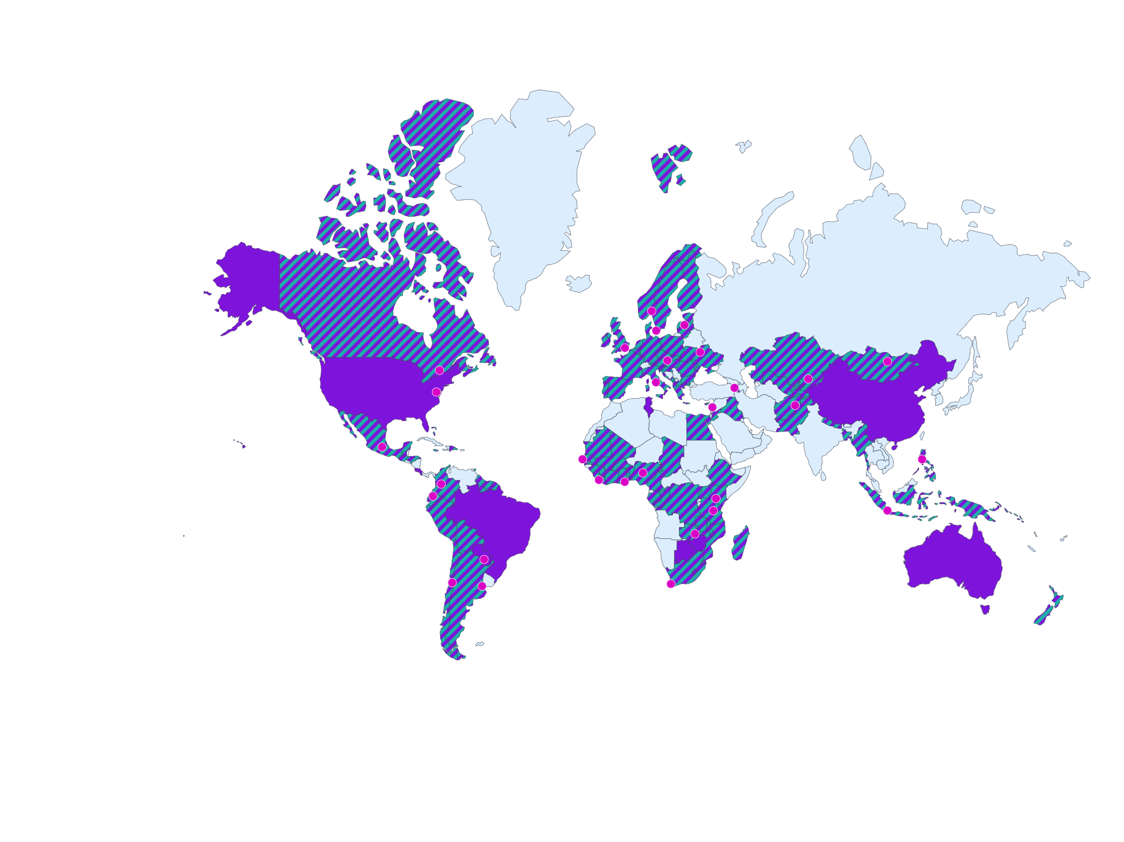
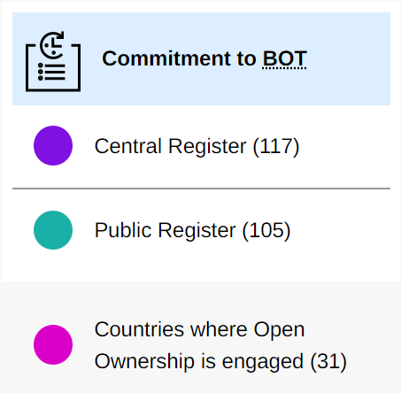
Where is the world on BOT? - Commitments
Source: www.openownership.org/map (updated May 2022)
Notes:
OO monitoring

Slide 5
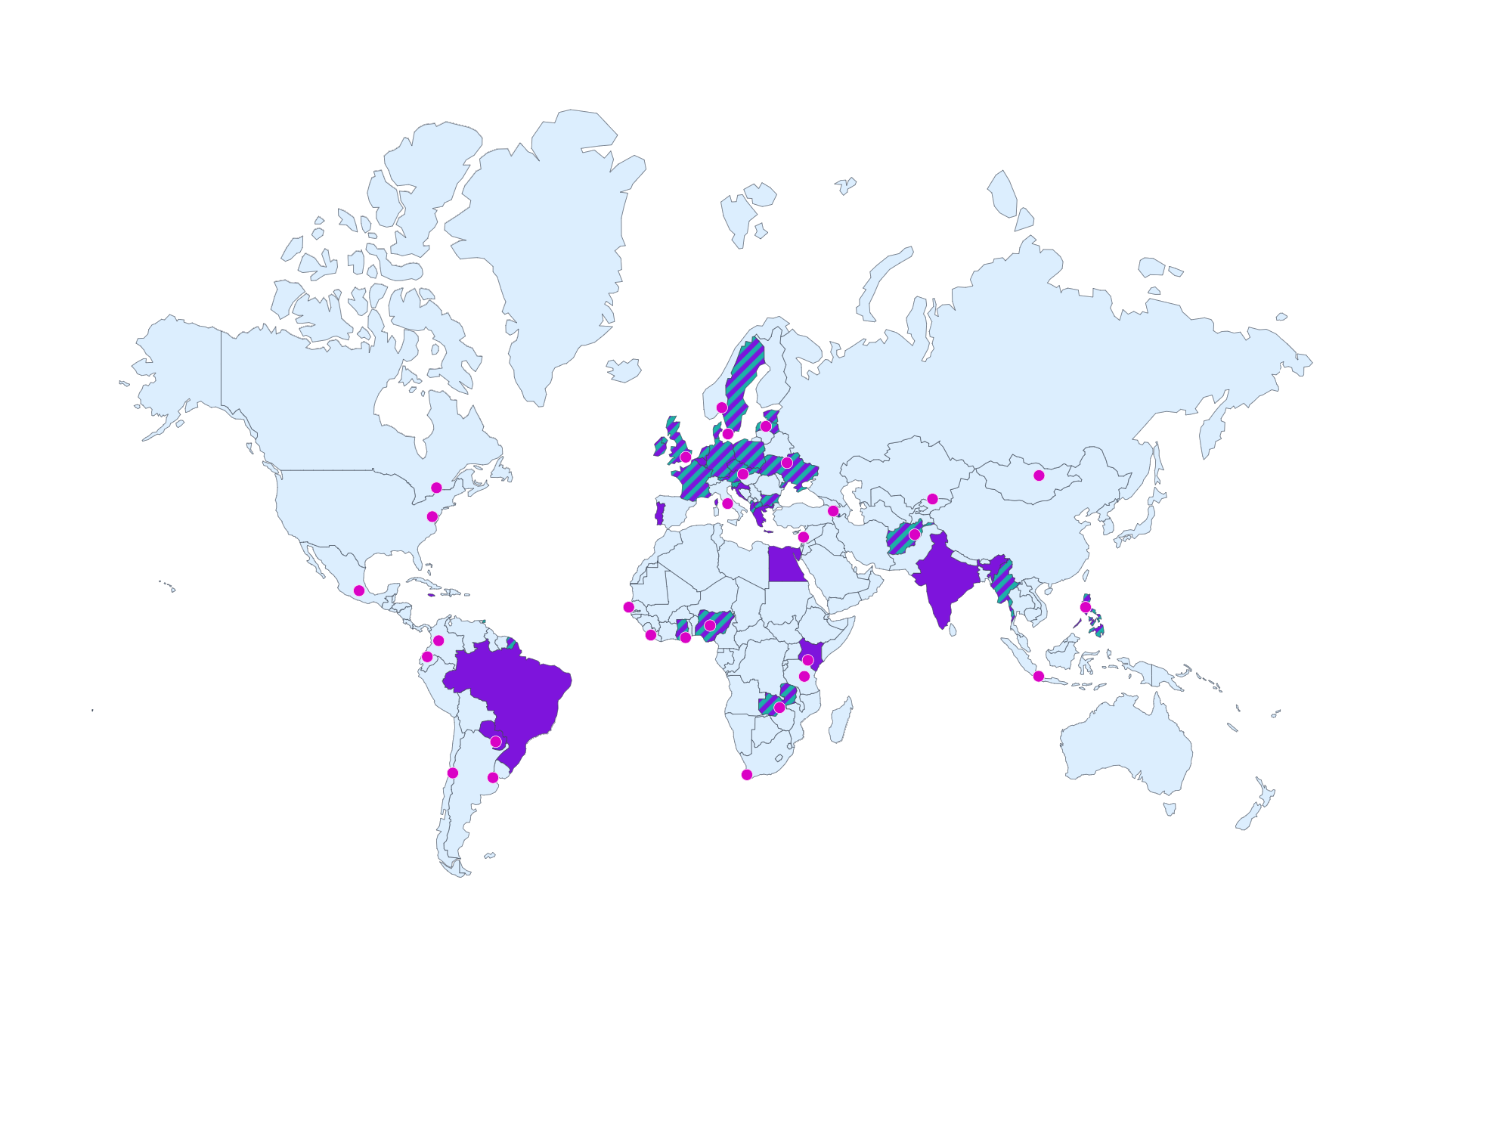
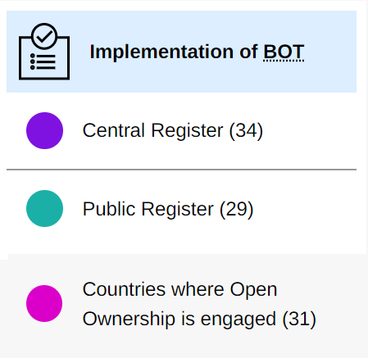
Implementation: happening but support needed
Source: www.openownership.org/map (updated May 2022)
Notes:
Regional variation - Europe, Africa ahead; progress in Asia Pacific & N America; limited progress in LAC

Slide 6
Entry points / drivers of BOT reform
Anti-money laundering: e.g. EU AMLD5; FATF compliance
Extractives: EITI Standard (55 implementing countries)
Procurement reform: e.g. IMF financing requirements
National security: e.g. US Corporate Transparency Act
Notes:
Why are countries implementing?
Procurement - accelerated by pandemic
Nat sec - accelerated by Russia’s invasion of Ukraine

Slide 7
Evolving international standards & commitments
2020-21 - BOT in IMF COVID financing
2021 - UNCAC BO resolution
2022 - FATF R24 revisions
2022 - G7 commitment to implementation in Africa
By 2022 - 33 countries have OGP commitments to BOT
Notes:
2020-21 - BOT requirements in IMF COVID response financing
2021 - UNCAC BO resolution (soft wording)
2022 - FATF R24 revisions (effectively = central registers)
2022 - G7 commitment to support implementation in 15 African countries
By 2022 - 33 countries have OGP commitments to BOT

Slide 8
How is implementation happening?
Starting with extractives then progressing to other sectors (Armenia, Nigeria)
Starting with a centralised non-public register then (planning to) make data public (Kenya)
Public register for all sectors of the economy (Ukraine)

Slide 9
Three key trends
More focus on implementation
Much more focus on using data, not just publishing it
Expansion of stakeholders interested in BOT
Notes:
More focus on implementation (not just commitment)
Much more focus on using data, not just publishing it
Expansion of stakeholders interested in BOT (e.g. energy transition)

Slide 10
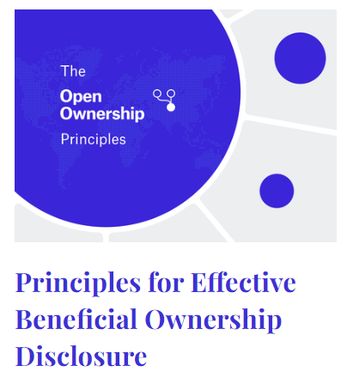
What is effective implementation?
A framework rather than a ‘standard’
Effective = data can be used to achieve policy & business goals of users
Developed from direct implementation experience + primary & secondary research & public consultation
See: www.openownership.org/en/principles
Notes:
Research by eg WB, FATF, OECD, OO, TI, TJN etc

Slide 11
The Open Ownership Principles
Robust definition
Comprehensive coverage
Sufficient detail
Central register
Public access
Structured data
Verification
Up to date and auditable
Sanctions and enforcement
} Disclosure + collection
} Availability + accessibility
} Quality + reliability

Slide 12
Emerging best practices: Defining BO
Armenia: Lowering thresholds (20% -> 10%)
Ghana: risk based approach (0% for domestic extractives companies; 5% for foreign)
South Africa: harmonising legislation
US: robust, clear definition focussed on substantive ownership/control (but high threshold)
Notes:
South Africa: harmonisation of legislation, getting it right from the start (although progress is slow)
They have a number of BO definitions that contradict (one is confusingly called “beneficial interest”). They have an FIU definition which is FATF conformant (natural person/direct+indirect/ownership+control) but nothing else. FIU is keen to use this, so idea is to build on/expand this (ideally primary, or otherwise secondary leg)
US (solid def but big exemptions in terms of which companies will need to disclose)
CTA
Very clear prohibitions of what is not a BO (nominees, etc.)
Very clear about this is not ownership/control that derives from employment alone (therefore avoiding issue of senior management confusion)
Includes both substantial control and deriving substantial economic benefits (including enjoyment of assets)
However, has a “specified levels of operation” exemption for large US companies with over 20 employees or filing over $5million in sales
Because the law is targeting domestic shell companies so if a domestic company has substantial operations it’s not a shell company
So very much a financial crime angle

Slide 13
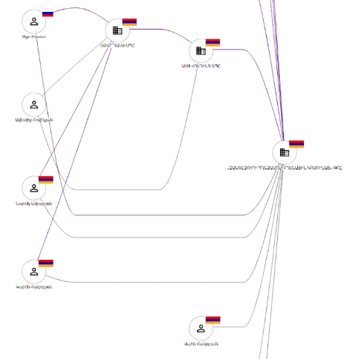
Emerging best practices: structuring data
Why?
Beneficial Ownership Data Standard: Armenia, Latvia, Nigeria now implemented; others in progress/committed to doing so (BO Leadership Group members + Portugal & others)
Source: Armenian e-registry; excerpt from a BO disclosure of a gold mining company generated using BODS

Slide 14
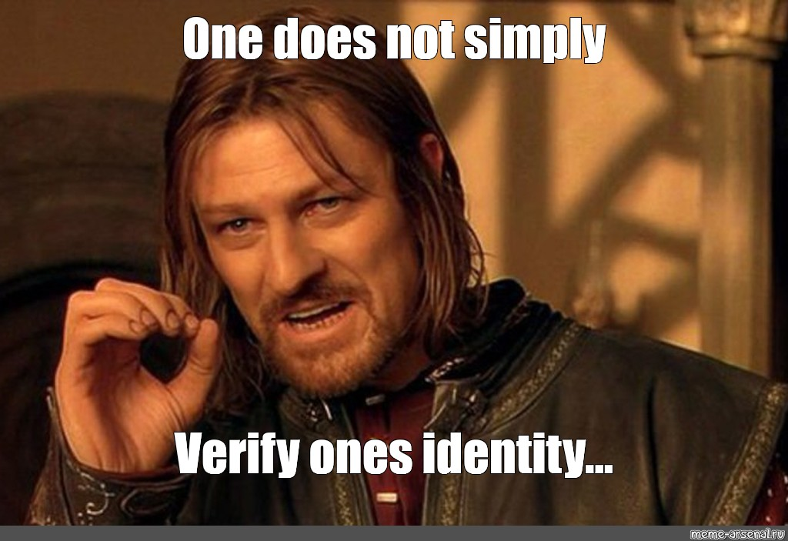
Verification: the thing no-one is doing well, yet

Slide 15
Verification: the thing no-one is doing well, yet
… except for Slovakia, perhaps?
Verification of information about ownership and control: does this person really own/control this company?
Slovakia: Register of Public Sector Partners - notarised information; reversed burden of proof
Armenia: full ownership chains (extractives)
Notes:
Slovakia - reverse burden of proof. The register has independent oversight and is governed by a Registration Court. Anyone can submit a claim querying data to the Registration Court, and if the Court finds it reasonable, there is a proceeding to require the company to verify the data they submitted.

Slide 16
What’s next for the international BOT agenda?
More implementation
Technical assistance
Growing the marketplace of actors and products to deliver
More R&D
New evidence to shape policy & technology priorities
More use of BO data
Impact stories & more evidence that BOT works
Iterative improvement of registers
Notes:
1 - More implementation please! = more technical assistance; growing the marketplace for companies and organisations that can develop effective legal frameworks and build effective registers
2 - More R&D: There’s still a lot we don’t know. New evidence is needed to shape future implementation priorities.
3 - More use of BO data. Now more registers exist, we need concerted efforts to make use of the data -> impact stories & more evidence that it works, but also using the data tells us how to make registers better.

Slide 17
Questions?
Louise Russell-Prywata: louise@openownership.org
Twitter: @_LouiseRP
Technical Helpdesk:
support@openownership.org
Twitter: @OpenOwnership

