Slide 1
Availability of Beneficial Ownership data across the European union
Maíra Martini Research and Policy Expert - Corrupt Money Flows, Transparency International

Slide 2
How useful is beneficial ownership data?
Government authorities / Law enforcement
Better intelligence work by Financial Intelligence Units
proactive investigations by law enforcement authorities, tax agencies.
Simplified cross-border investigations and international cooperation
Anti-money laundering risk analysis
Private sector
Fraud and loss prevention
Assessment of potential investments and risks
Anti-money laundering compliance (due diligence by obliged entities)
Integrity, risk screening, due diligence (e.g supply chain)
Competitive advantage
CSOs / Journalists / Academia
Analyse patterns, red flags and areas of risk
Verify accuracy of information & quality of the data
Detect and expose potential wrongdoing
Assess loopholes and recommend improvements to coverage, data collection and use
@mairarmartini

Slide 3
EU AML framework
1991 1st AMLD
2015 4th AMLD
2018 5th AMLD
2021 AML Package (4 proposals)
2001 2nd AMLD
2005 3rd AMLD
@mairarmartini
Notes:
Anti-Money Laundering Directives
Regulations
Other legislative instruments
Aligned with international AML standards (e.g., FATF Recommendations)

Slide 4
EU BOT framework: registers (1)
Central and public BO register of legal entities (companies, foundations, etc)
Central BO register of legal arrangements (trusts, fiducie)
Accessible to:
competent authorities and FIUs, in a timely manner, without any restriction
obliged entities (banks, DNFBPs), when performing CDD activities
any member of the public
Accessible to:
competent authorities and FIUs, in a timely manner, without any restriction
obliged entities (banks, DNFBPs), when performing CDD activities
any natural/legal with a legitimate interest (CSOs, journalists, companies).
* Public access in some EU MS: Austria, Bulgaria, Croatia, Germany, Netherlands (will be), Poland, Portugal, Slovenia and Sweden
@mairarmartini

Slide 5
EU BOT framework: registers (2)
Information on the beneficial owner collected differs from the information disclosed to the public (balancing public interest and privacy concerns)
At a minimum, the public should have access to:
Name
Month and year of birth
Country of residence
Nationality
Nature of the beneficial ownership interest held
Extent of the interest held
@mairarmartini
Notes:
Countries could choose to disclose other types of information

Slide 6
EU BOT framework: registers (3)
At the discretion of each MS:
Registration requirement
Payment of fees
EU Open Data Directive 2019
“high-value datasets”, including company data should be available for free, in open data format across the EU.
However, the Implementing Regulation proposed by the European Commission significantly limits which data about company owners should be made public for free. In particular, it excludes the names of company owners. A public consultation on the proposal is open until June 21.
@mairarmartini
Notes:
Countries could choose to disclose other types of information

Slide 7
Which countries have a BO register of legal entities?
Are registers accessible to the public?
Are there restrictions to access the information?
What are the search and download functionalities?
What are the types of information available?
We did not look at compliance rates and quality of the information…

Slide 8
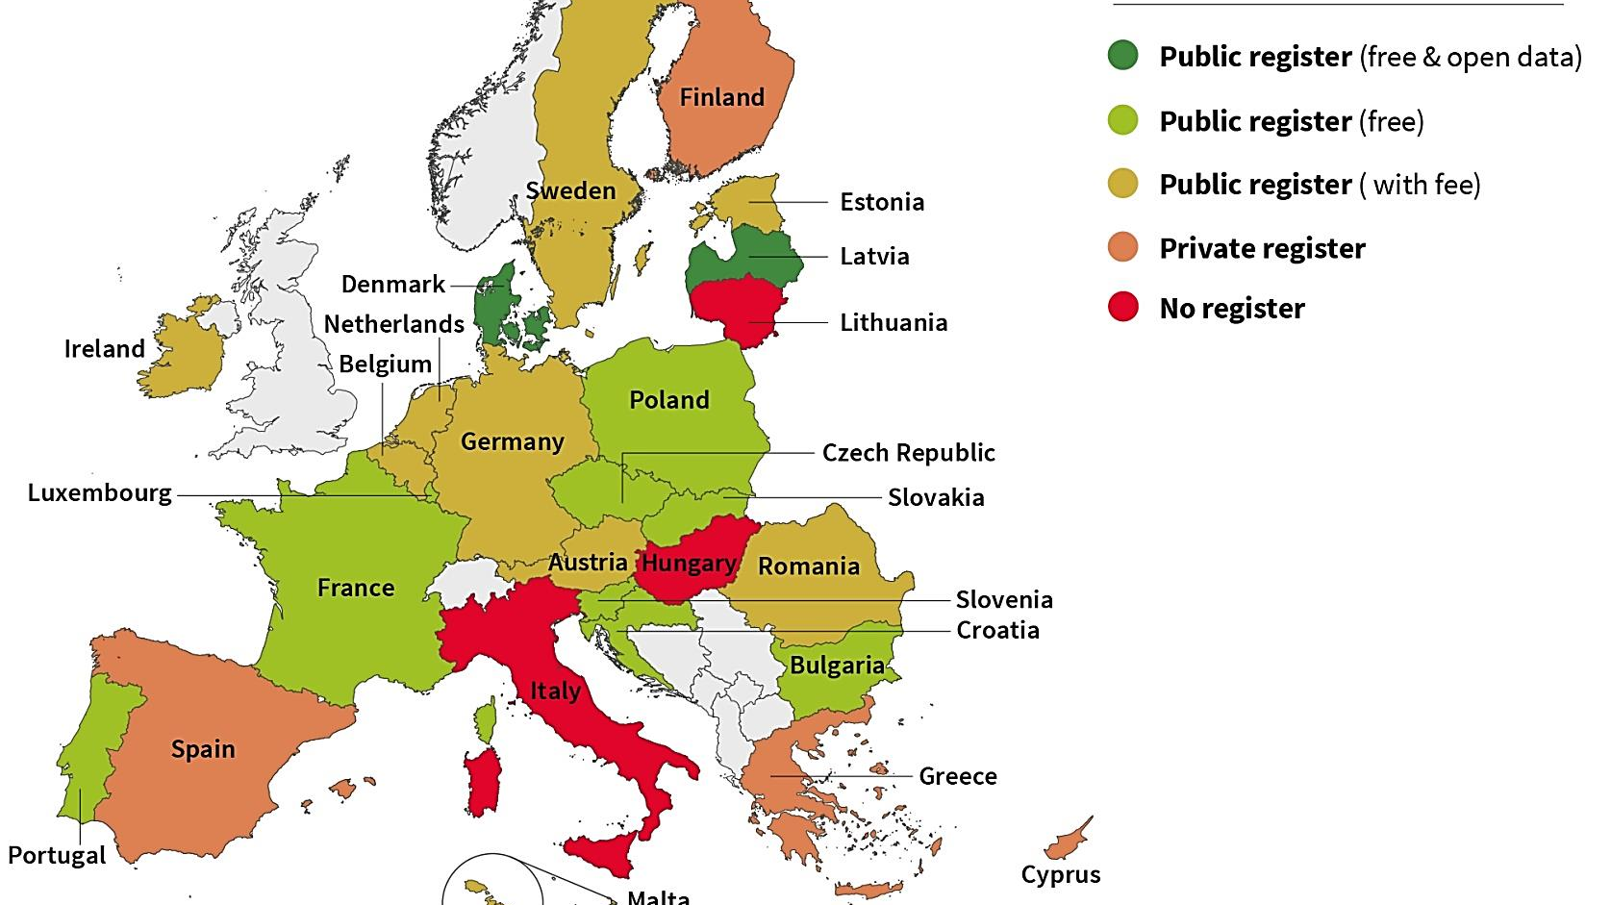

Slide 9
Access functionalities
Electronic identification systems
Online registration
Fees upon access
Access restricted to people from certain countries
Complex registration systems based on electronic identification (e.g., BE, HR, SE, PT)
9 countries (AU, BE, HR, DE, IE, NL, PT, RO, SE)
In some cases, it constitutes an obstacle to access
8 countries (AU, BE, EE, DE, IE, MT, NL, RO). Price range: from €1.00 to €5.00.
In some countries, fees are charged for accessing specific types of information (e.g., SE: €27 for purchasing a BO certificate)

Slide 10
Search & download functions
Search
Download
Most MSs allow search ONLY by the name of the legal person.
Some allow also search by BO (e.g., BG, DK, FR, MT, PL, SE)
Necessary to input the exact name of the company (no name reconciliation services) (e.g., AT, SE)
Necessary to declare the reason why the user is conducting the search (e.g., PT)
Search available only in national languages (e.g., in Bulgaria search available only in Cyrillic)
Most registers: Unstructured data, not available in a machine-readable format.
Only Denmark and Latvia allow for the download of the data in a structured manner and for free.

Slide 11
Country | Name | Month and year of birth | Country of residence | Nationality | Nature of interest | Extent of interest
Austria | Yes | Yes | Yes | Yes | Yes | Yes
Belgium | Only the surname | Only month of birth | Yes | No | Yes | Yes
Bulgaria | Yes | No | Yes | Yes | Yes | Yes
Croatia | Yes | Yes | Yes | Yes | Yes | Yes
Czech Republic | Yes | Yes | Yes | Yes | Yes | No
Denmark | Yes | No | Yes | No | Yes | Yes
Estonia | Yes | Yes | Yes | Yes | Yes | No
France | Yes | Yes | No | Yes | Yes | Yes
Germany | Yes | Yes | Yes | Yes | Yes | Yes
Ireland | Yes | Yes | Yes | Yes | Yes | Yes
Latvia | Yes | Yes | Yes | Yes | Yes | Yes
Luxembourg | Yes | Yes | Yes | Yes | Yes | Yes
Malta | Yes | Yes | Yes | Yes | Yes | Yes
Netherlands | Yes | Yes | Yes | Yes | Yes | Yes
Poland | Yes | Yes | Yes | Yes | Yes | Yes
Portugal | Yes | Yes | No | Yes | Yes | Yes
Romania | NA | NA | NA | NA | NA | NA
Slovakia | Yes | Yes | Yes | Yes | No | No
Slovenia | Yes | No | Yes | No | Yes | Only available in ranges
Sweden | Yes | Yes | Yes | Yes | Yes | Yes

Slide 12
Country | Additional information
Belgium | Date on which the natural person became the BO
Czech Republic | Date on which the natural person became the BO
Denmark | Date on which the natural person became the BO; list of firms owned by the BO as well as all firms registered at a given address.
Ireland | Residential address and address code; Date on which the natural person became the BO; date of cessation as BO; personal Public Service Number; type of control.
Latvia | Date on which the natural person became the BO; historical data (upon registration).
Luxembourg | BO’s birthplace and date of the last declaration.
Malta | Date on which the natural person became the BO
Netherlands | Date on which the natural person became the BO; registration date.
Poland | Date of birth; ID number.
Portugal | Whether the BO is of legal age, place of birth, permanent address, unique identifiers.
Slovenia | Address of permanent/temporary residence and registration date.

Slide 13
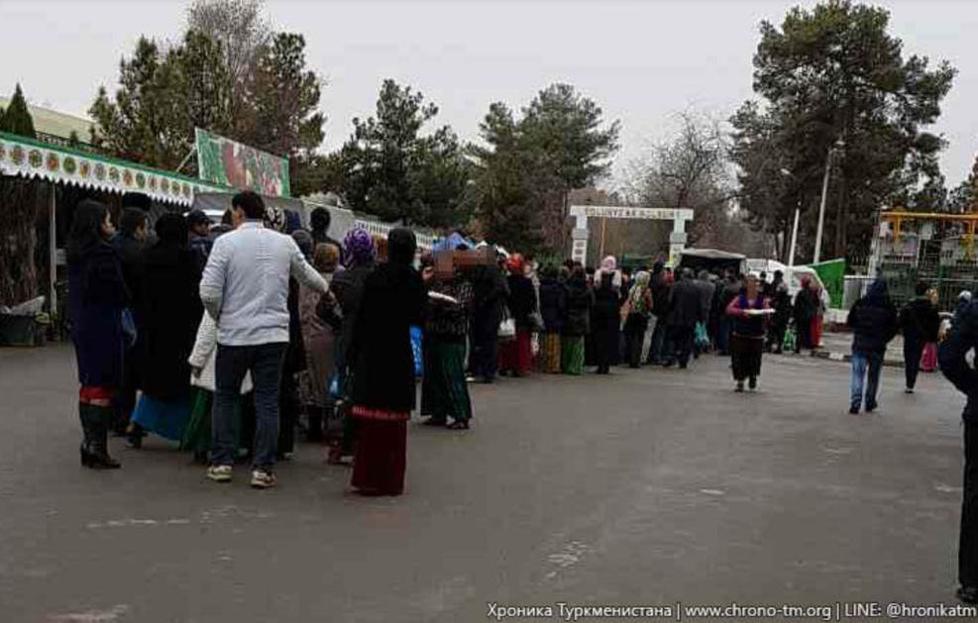
IMPACT EXAMPLES

Slide 14
The new EU AML package
July 2021: Four proposals currently under negotiation
Regulation to establish a new EU AML/CFT authority (COM(2021)421 final) – Anti-Money Laundering Authority (AMLA)
Regulation on the prevention of the use of the financial system for the purposes of ML/TF (AMLR) – (COM(2021)420 final)
Recast of Regulation (EU) 2015/847 expanding traceability requirements to crypto-assets (TFR) (COM (2021)422 final)
6th AML/CFT Directive (COM (2021)423 final)
@mairarmartini

Slide 15
The new EU AML package: Beneficial ownership transparency
Proposal for a 6th AML directive:
submission and storage of BO information in the registers;
harmonisation of rules to ensure the adequacy, the accuracy and the timeliness of BO data;
verification of BO information.
Proposal for a Regulation (AML Rulebook):
registration of the BOs of foreign legal entities in a national BO register when they own real estate properties or enter into a business relationship with an EU MS;
disclosure of the status of nominee shareholders and directors and the identity of the person(s) on whose behalf they are acting.
@mairarmartini

Slide 16
The way forward
Global level playing field: New global standard that requires beneficial ownership registers as part of a multi-pronged approach (FATF review).
Effective regimes: Countries should review their beneficial ownership transparency frameworks to ensure their effectiveness, including by creating or strengthening existing beneficial ownership registers, changing BO definitions, etc.
Making use of BO data: Build the capacity and raise awareness of competent authorities, businesses, civil society and journalists of the power of beneficial ownership data.
@mairarmartini

Slide 17
Thank you!
E-mail: mmartini@transparency.org
Twitter: @mairarmartini
www.linkedin.com/in/martinimaira

Slide 18
A new global standard on beneficial ownership transparency – FATF Rec 24
Multi-pronged approach: BO information available from three sources
Registers with BO information a requirement (or alternative mechanism)
Verified data
Access to BO data by public procurement authorities
@mairarmartini
Notes:
Applied across more than 200 jurisdictions. Reviews undertaken by FATF or regional bodies with follow up mechanism. Non-compliance with FATF standards can put countries in a grey or blacklist.

Slide 19
A new global standard on beneficial ownership transparency – FATF Rec 24
Controlling interest threshold should be based on risk, with a maximum 25%
BO disclosure requirements to high-risk foreign companies with links to the country
Stricter rules on nominee shareholders and directors
Bearer shares prohibited
@mairarmartini
Notes:
requiring nominee shareholders and directors to disclose their nominee status and the identity of their nominator to the company and to any relevant registry, and for this information to be included in the relevant register, and for the information to be obtained, held or recorded by the public authority or body or the alternative mechanism referred to in paragraph 7. Nominee status should be included in public information; (b) requiring nominee shareholders and directors to be licensed62 , for their nominee status and the identity of their nominator to be obtained, held or recorded by the public authority or body or alternative mechanism referred to in paragraph 7 and for them to maintain information identifying their nominator and the natural person on whose behalf the nominee is ultimately acting63, and make this information available to the competent authorities upon request; 64.or (c) enforcing a prohibition of the use of nominee shareholders or nominee directors.

